Slide 1
Flipkart Product Data Analysis
Presented By:
Prashanth
Abhisheka b c

Slide 2
INTRODUCTION
The Flipkart products collection offers a comprehensive array of information about various products available on the Flipkart e-commerce platform. This collection includes attributes such as product names, categories, prices, ratings, and reviews, providing a valuable resource for analyzinge consumer behavior, market trends, and product performance.

Slide 3
Objectives
Data Exploration: Conduct an exploratory data analysis (EDA) to understand the structure, summary statistics, and key features.
Price Analysis: Analyze the pricing strategies of different product categories and identify any trends in product pricing.
Customer Ratings: Evaluate the impact of customer ratings on product sales and overall customer satisfaction.
Category Performance: Assess the performance of various product categories based on sales volume, ratings, and customer feedback.

Slide 4
About the Dataset
Source: The dataset will be sourced from Kaggle.
Features: Key features include Product_ID, Product_Title, Product_Rating, Category, Discounted_Price and Actual_Price, Discount_Percentage.
Purpose:
Identify the average discount per category.
Enhance service through product count and category.

Slide 5
Methodology
The project will follow a structured approach:
• Data Collection:
The dataset will be sourced from Kaggle, ensuring it is well documented and reliable.
• Exploratory Data Analysis (EDA):
Handle missing data using imputation techniques, Summarize the dataset using descriptive statistics and Create visualizations (e.g., histograms, box plots, correlation heatmaps) to understand feature distributions and interactions.
• Visualization:
Generate visual representations of findings to support conclusions.

Slide 6
TOOLS AND TECHNOLOGIES
Programming Language: Python.
Libraries: Pandas, NumPy, Matplotlib, Seaborn and mysql.connector. Database: MySQL for backend data storage.
IDE: Jupyter Notebook or any Python-compatible IDE

Slide 7
SQL connection and Table Creation
Installing My sql connector: pip install mysql-connector-python.
Creating the database:
connection = mysql.connector.connect(
host='localhost', # Replace with your MySQL host
user='root', # Replace with your MySQL user
password='9535', # Replace with your MySQL password
database='demo' # Replace with your database name )
connection.close()

Slide 8
Table Creation And Insertion
Set Up the Database Connection: We will connect sql to the python dataframe.
Creating a Table in the Database: Use sql to create tables statements to create table.
Inserting Data into the Table: Inserting to csv datafile to sql query.
Closing the Connection: Always close the connection to free up resources.

Slide 9
EXPLORATORY DATA ANALYSIS (EDA)
Importing Libraries: Import essential libraries for data manipulation and visualization.
Loading Dataset: Establish a connection to the database and load the data into a Pandas DataFrame.
Basic Exploration : Perform an initial examination of the dataset to understand its structure.
Checking Missing Values: Identify missing values in the dataset.
Descriptive Statistics: Summarize the dataset to understand the central tendency and spread of the data.
Identifying Duplicates: Check for duplicate rows in the dataset.
Data Visualization: Use visualizations to gain more insights into the data

Slide 10
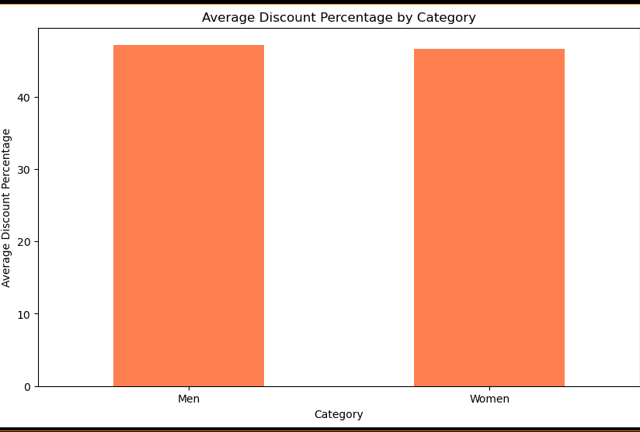
Average Discount Percentage Per category

Slide 11
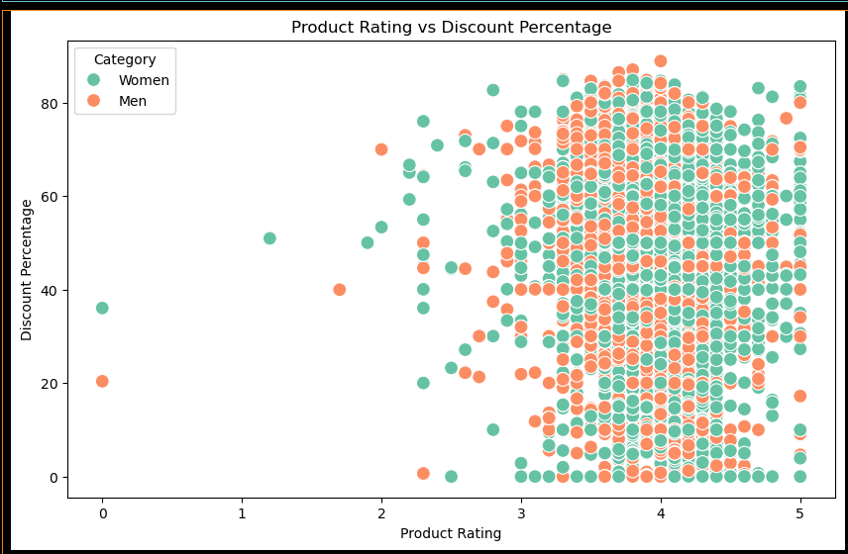
Product Rating vs Discount Percentage

Slide 12
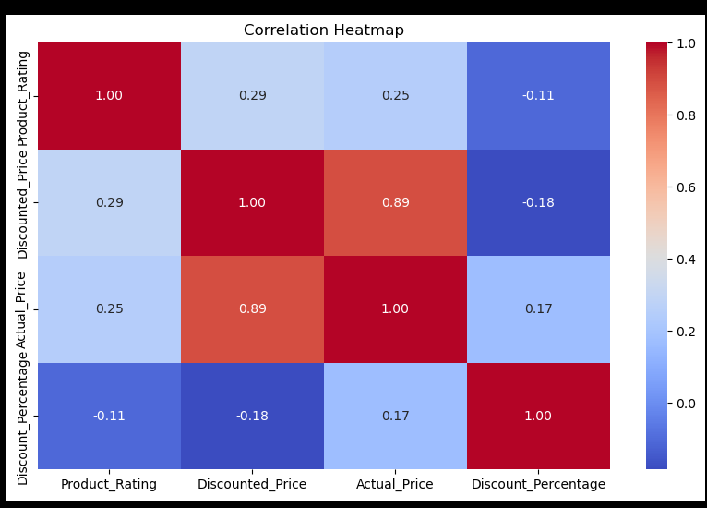
Correlation HeatMap

Slide 13
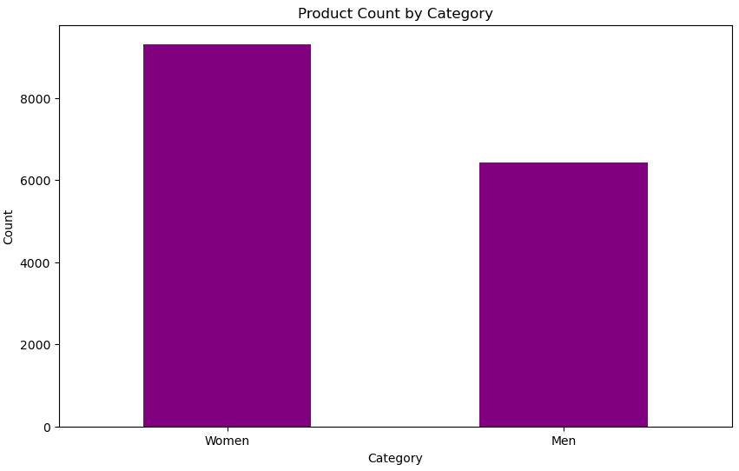
Product Count By Category

Slide 14
Conclusion
The Flipkart product data analysis offers critical insights into consumer preferences, product performance, and market trends. It enables data-driven strategies for optimizing product offerings, improving inventory management, and enhancing customer satisfaction, ultimately driving business growth and operational efficiency.

